Slide 1

Introduction to Artificial Intelligence Group 1 Week 5
Dr. Juan Carlos Rojas
Juan-Carlos.Rojas@ttu.edu

Slide 2
Schedule
Date | Class | HW Assigned | HW Due
May 18 | Class 1 | HW1
May 25 | Class 2 | HW2 | HW1
June 1 | Class 3 | HW3 | HW2
June 8 | Class 4 | HW4 | HW3
June 15 | No class
June 22 | Class 5 | HW5 | HW4
June 29 | Class 6 | HW6 | HW5
July 6 | Class 7 | HW7 | HW6
July 13 | Class 8 |  | HW7

Slide 3
Agenda for Week 5
Theory
TensorFlow
TensorFlow basics
Matrix operations
Gradient computations
Mini-batch gradient descent
Practice
Tensorflow
Basic computations
Solving Normal equations
Gradient descent
Logistic regression
Softmax regression
Mini-batch training

Slide 4
Aviso Importante
Para todos los becados por el MICITT, es obligatorio llenar un formulario inicial de participantes que pueden localizar en el siguiente enlace:
http://www.conicit.go.cr/tramites/Seguimiento_PINN.aspx.
Buscar “Formulario de información inicial para los participantes”, y seguir el vínculo al formulario electrónico.
Este formulario es parte obligatoria de su beca, por lo que el 100% de los becados deben llenarlo.

Slide 5
TensorFlow

Slide 6

TensorFlow
A generic computation framework developed by Google
You first create a description of the computation
Then you execute it
The framework of choice for neural networks
Maps well to GPUs
Requires special installation
Can map to clusters of computers

Slide 7
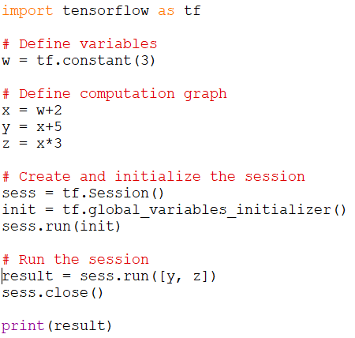
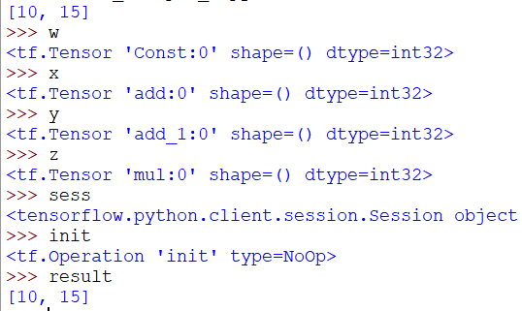
TensorFlow Example 1
See TensorFlow_Example_1.py

Slide 8
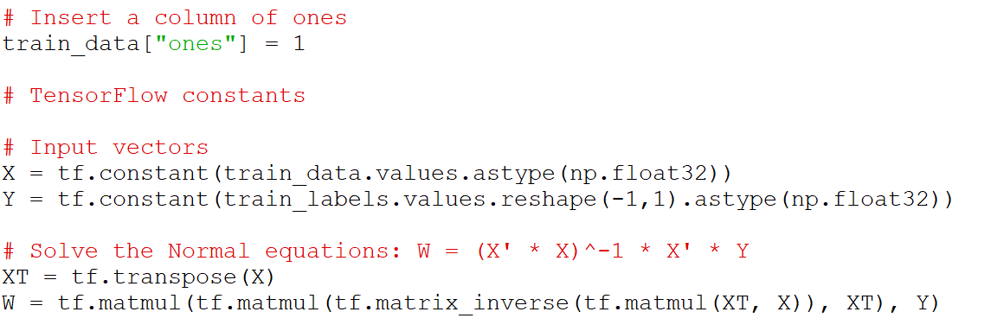
Solving Normal Equations in TensorFlow
We can operate in vectors and matrices in TensorFlow
For example, we can solve the Normal equations
See VehiclePrice_LinearRegression_tf_1.py

Slide 9
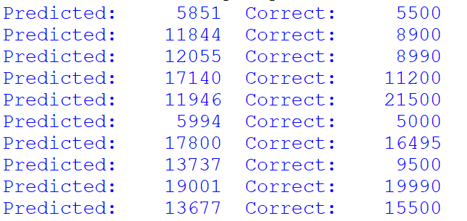
Practice 1
Use Tensorflow to solve the Normal equations of a linear regression model of vehicle prices
See VehiclePrice_LinearRegression_tf_1.py
Add TensorFlow instructions to compute the prediction values against the test dataset
Hints:
You need to declare a vector for the test data
Multiply it by W
Print the first 10 prediction values
Compare with the first 10 correct label values

Slide 10
Solving Gradient Descent in TensorFlow
We can solve linear regression coefficients by gradient descent
Algorithm:
Define the input vectors for X and Y
Initialize the vector of coefficients to random values
Compute the prediction Y_pred = X * W
Compute the MSE
Compute the gradient of the MSE w.r.t. each feature
Update the coefficients as W - learning_rate * gradients
Repeat 3-6 until converged, or after a given number of iterations
This is considered a batch approach
We are using all available data at every iteration

Slide 11
Computing Gradients
There are several possible methods:
Numerical differentiation
Fast but inaccurate
Symbolic differentiation
Slow and complicated
Forward-mode automatic differentiation
Computation is broken down into basic arithmetic operations whose derivative is known
Chain-rule is used to compute the numerical result
Accurate
Reverse-mode automatic differentiation
The same, but working from the output backward to the input
Saves computations when there are few outputs
TensorFlow uses reverse-mode auto-diff
Accurate & fast
Recommended reading:
https://www.cs.toronto.edu/~rgrosse/courses/csc321_2018/slides/lec10.pdf

Slide 12
Solving Gradient Descent in TensorFlow
Define the input vectors for X and Y
Initialize the vector of coefficients to random values
Compute the prediction Y_pred = X * W
Compute the MSE
See VehiclePrice_LinearRegression_tf_2.py

Slide 13
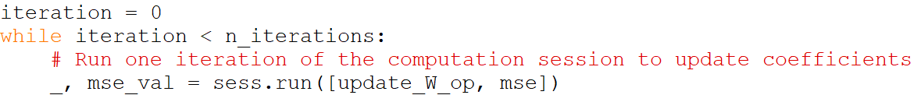
Solving Gradient Descent in TensorFlow
Compute the gradient of the MSE w.r.t. each feature
Update the coefficients as W - learning_rate * gradients
Repeat 3-6 until converged, or after a given number of iterations
See VehiclePrice_LinearRegression_tf_2.py

Slide 14
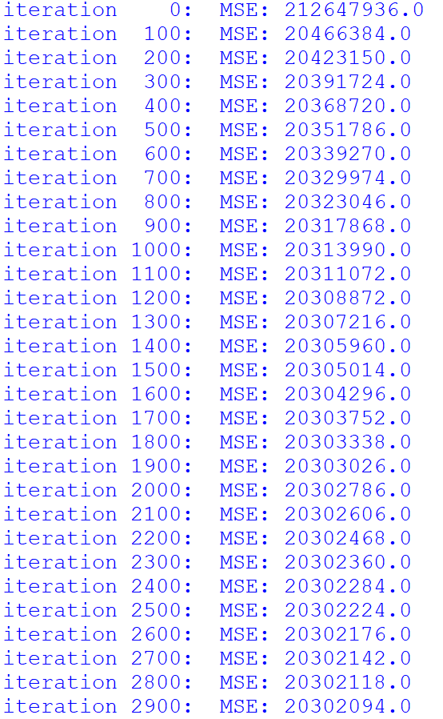
Solving Gradient Descent in TensorFlow
The algorithm gradually reduces the MSE
It takes a few 1000s of iterations to converge
Depends on the learning rate
See VehiclePrice_LinearRegression_tf_2.py

Slide 15
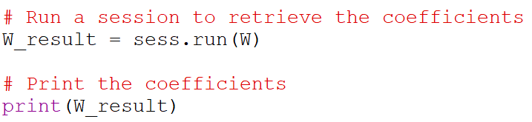
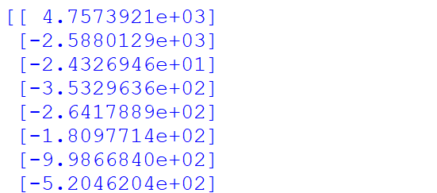

Solving Gradient Descent in TensorFlow
The coefficients can be retrieved by running a session for them:
The training RMSE is obtained from the MSE measurement we already have
See VehiclePrice_LinearRegression_tf_2.py

Slide 16
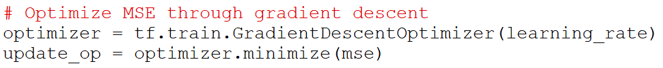
Using Tensorflow Optimizers
We can use a built-in gradient descent optimizer
Replaces steps 5 & 6 of the previous list
The results are the same
Runs a little bit faster
There are other kinds of optimizers (momentum, adagrad, etc.)
May converge faster
See VehiclePrice_LinearRegression_tf_3.py

Slide 17
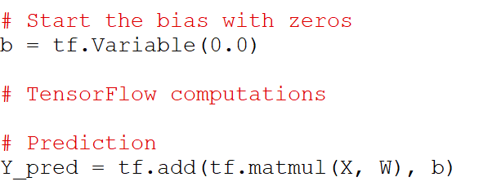
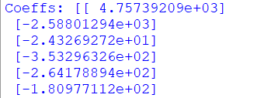
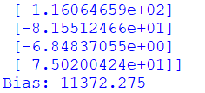
Using a Bias Variable
Instead of adding a column of ones, we can use a separate variable for the intercept weight
We will call it bias
The gradient optimizer will now update both W and b
The results are exactly the same as before
W has one less coefficient, which is now in b
See VehiclePrice_LinearRegression_tf_4.py

Slide 18

Practice 2
Use Tensorflow to to solve a linear regression model for vehicle prices using gradient descent
You can base it on VehiclePrice_LinearRegression_tf_4.py
Add Tensorflow instructions to compute the RMSE of the test predictions against the test labels
Hints:
Compute the predictions against the test data as Y_pred_test = X_test * W + b
Compute the test MSE as test_mse = tf.reduce_mean(tf.square(Y_pred_test - Y_true_test))
At the end, run a TensorFlow session to compute the value of test_mse

Slide 19
Optional HW Problem 2b
Adjust the learning rate in the gradient descent solution of the vehicle price linear regression
What happens if the learning rate is very large?
What happens if it is very small?

Slide 20
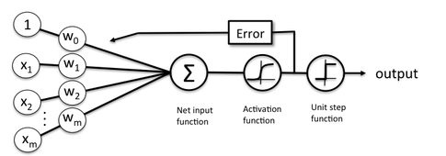
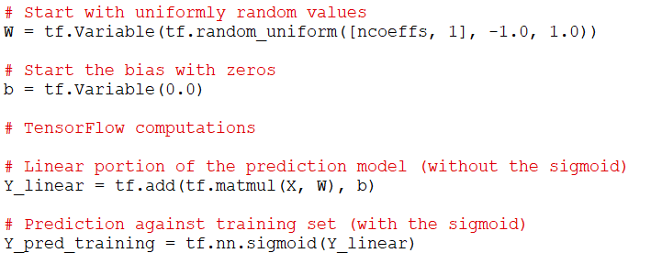
Implementing Logistic Regression in TensorFlow
We use the same gradient descent approach
One vector of coefficients plus a bias
We add a sigmoid function to the prediction
See CreditDefault_LogisticRegression_tf_1.py

Slide 21
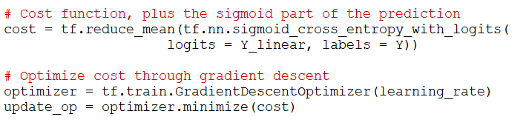
Implementing Logistic Regression in TensorFlow
For the cost function, we use a built-in TensorFlow cross-entropy function
It includes the sigmoid function, so we pass-in only the linear portion
This produces a cost value for each test case
We compute an average of all of them
Optimize by gradient descent as before
See CreditDefault_LogisticRegression_tf_1.py

Slide 22
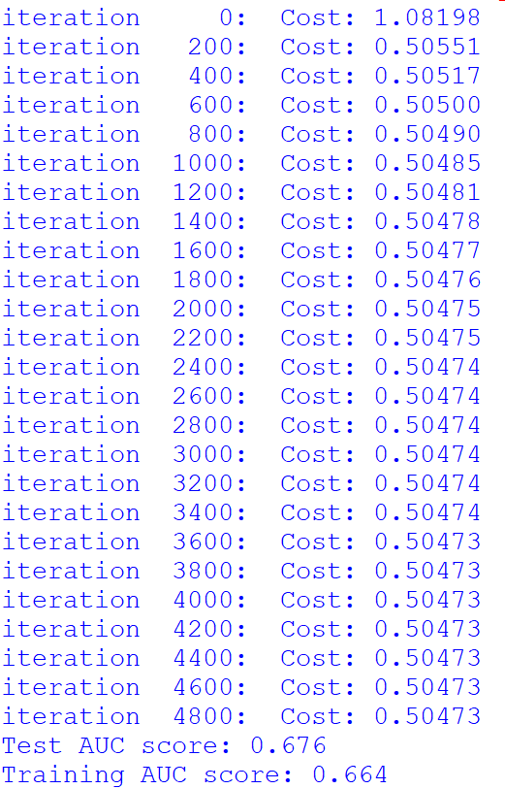
Implementing Logistic Regression in TensorFlow
It converges after a few 1000s of iterations
Depends on the learning rate
See CreditDefault_LogisticRegression_tf_1.py

Slide 23
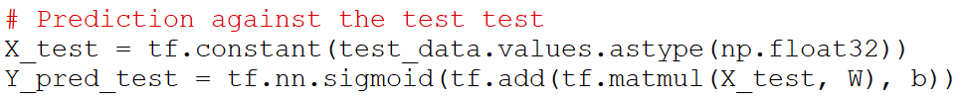
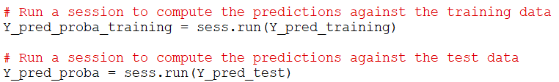
Implementing Logistic Regression in TensorFlow
To compute the predictions against the test set we need to add a few more computations
And then run a Tensorflow session to compute them
See CreditDefault_LogisticRegression_tf_1.py

Slide 24
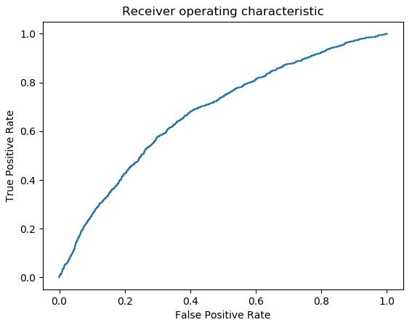
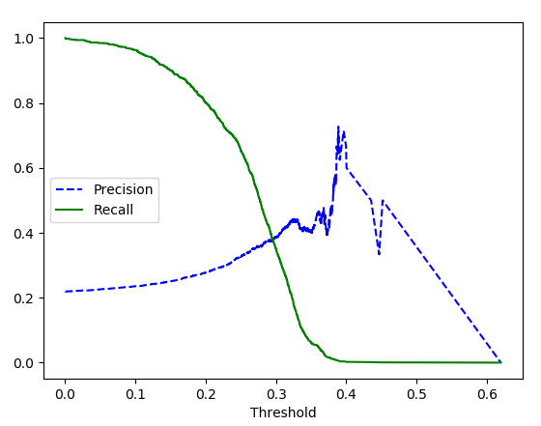

Implementing Logistic Regression in TensorFlow
The prediction probabilities can then be plugged-in to sklearn.metrics to evaluate the classifier
See CreditDefault_LogisticRegression_tf_1.py

Slide 25
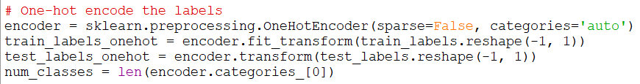

Softmax Regression in TensorFlow
Extending to multinomial classification follows the same structure
The labels need to be one-hot encoded
We can use sklearn.preprocess for this:
Use the one-hot-encoded labels as the matrix Y for training
See Mnist_SoftmaxRegression_tf_1.py

Slide 26
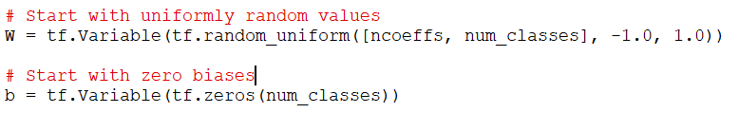
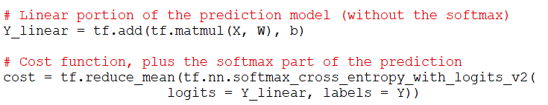
Softmax Regression in TensorFlow
Define the coefficient matrix (one row per class)
The biases are a vector (one per class)
We use the softmax version of the cost function:
See Mnist_SoftmaxRegression_tf_1.py

Slide 27
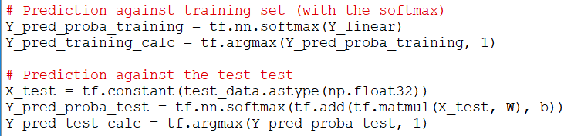
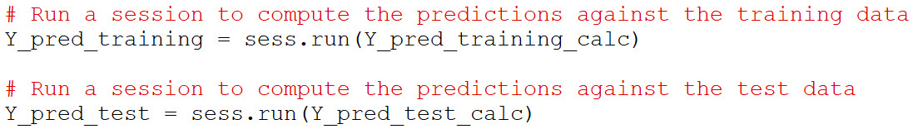
Softmax Regression in TensorFlow
We compute the probability similar to before
Use softmax instead of sigmoid
Determine the winning class by maximum
We run a session to compute them at the end
See Mnist_SoftmaxRegression_tf_1.py

Slide 28
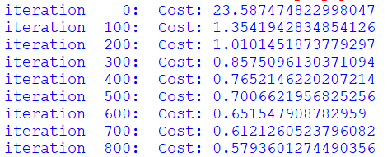
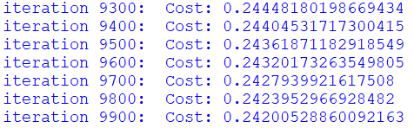
Softmax Regression in TensorFlow
The gradient descent is taking very long to run
It was not fully converged after 10,000 iterations!
We can try to increase the learning rate, but if we do it too much, it will have trouble converging
See Mnist_SoftmaxRegression_tf_1.py

Slide 29
Strategies to Speed-Up Convergence
Better initialization of coefficients
Xavier’s (Glorot) initialization
Learning-rate schedule
Linear decay
Exponential decay
Adaptive learning rate schemes
Momentum
Adagrad
RMSprop
Adam

Slide 30

Xavier’s Initialization
You can get faster convergence is you use initial coefficient values that distributed normally
Use a standard deviation such that
This is known as Xavier’s initialization, or Glorot initialization
See Mnist_SoftmaxRegression_tf_2.py

Slide 31
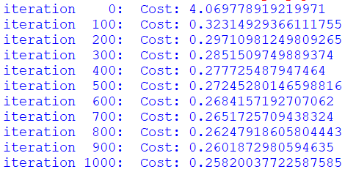
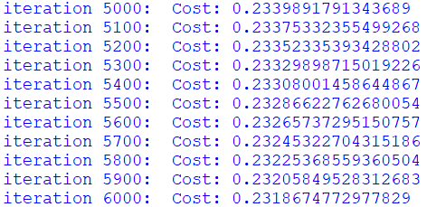
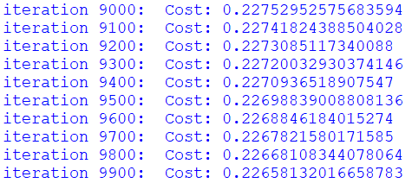
Xavier’s Initialization
This time it converges much faster
But it still takes close to 10,000 iterations to reach a stable value
We need something faster
Stochastic gradient descent
See Mnist_SoftmaxRegression_tf_2.py

Slide 32
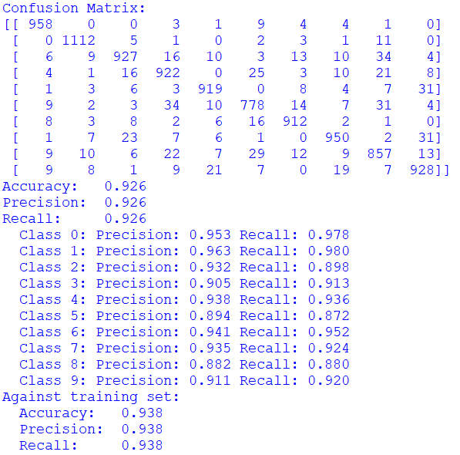
Softmax Regression in TensorFlow
The results are consistent with previous results from sklearn
See Mnist_SoftmaxRegression_tf_2.py

Slide 33
Optional HW Problem 2c
Replicate the gradient descent solution for softmax regression of MNIST images
Use Mnist_SoftmaxRegression_tf_2.py as a base
Adjust the learning rate to make it converge faster
Can you get to the same test accuracy result?

Slide 34
Stochastic Gradient Descent

Slide 35
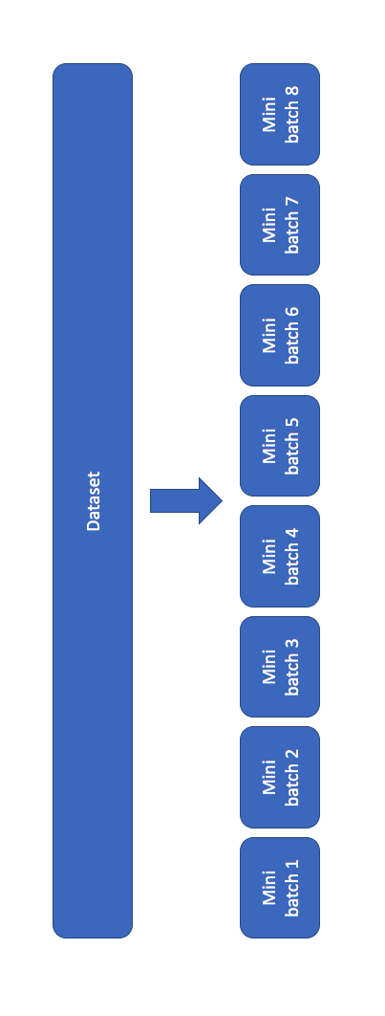
Stochastic Gradient Descent
Uses a random subset of the training data in every iteration
Picking a true random subset at every iteration is expensive
In practice, most people use mini-batch gradient descent instead
Mini-batch gradient descent:
Divide the training data into blocks and cycle through all of them
One block per update iteration
One pass through all of the blocks is called an epoch
Start by using the same number of total iterations as before
n_epochs * n_batches = n_iterations
Each update has less data, so it is faster
May need to increase the number of iterations later

Slide 36
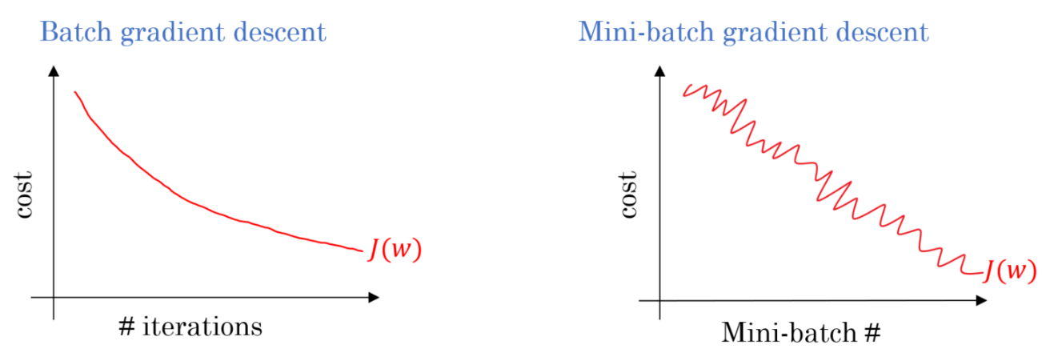
Stochastic Gradient Descent
The data is “noisier”
May need to reduce the learning rate
The cost value for each mini-batch may be different
Look at the average across all mini-batches
Or re-compute against the full training set once in a while

Slide 37
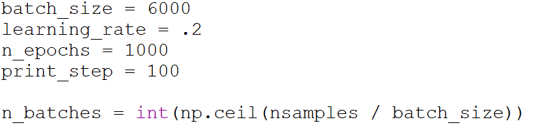
Mini-Batch Softmax Regression in Tensorflow
Select a batch size and compute the number of batches
This example uses 10 batches of 6000 samples each
The total number of iterations is n_epochs * n_batches = 10,000
See Mnist_SoftmaxRegression_tf_3.py

Slide 38

Mini-Batch Softmax Regression in Tensorflow
We will need to use Tensorflow placeholders
Allows us to feed different data to the computation later
Replace the input vectors with placeholders
None means that the length is left unspecified
See Mnist_SoftmaxRegression_tf_3.py

Slide 39
Mini-Batch Softmax Regression in Tensorflow
In the update loop, construct the data vectors for the batch
Put them into a “feed dictionary”
This is used to replace the placeholders for X and Y
Pass the dictionary to the session run
See Mnist_SoftmaxRegression_tf_3.py

Slide 40
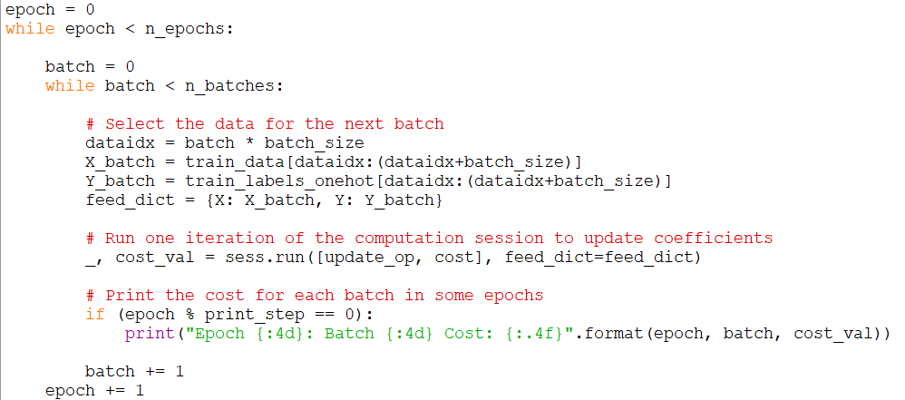
Mini-Batch Softmax Regression in Tensorflow
Update loop:
See Mnist_SoftmaxRegression_tf_3.py

Slide 41

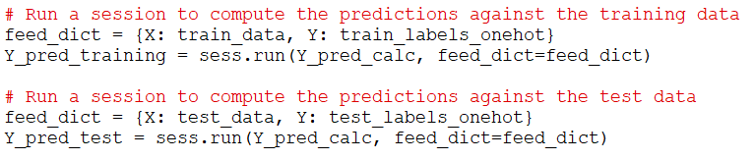
Getting the Prediction Values
We can take advantage of the feed mechanism to get prediction values for the test dataset
In the computation graph, just add the missing Softmax function and compute the maximum prediction value
In the testing, feed the entire test data (or entire train data) to get the full vector of predictions
See Mnist_SoftmaxRegression_tf_3.py

Slide 42
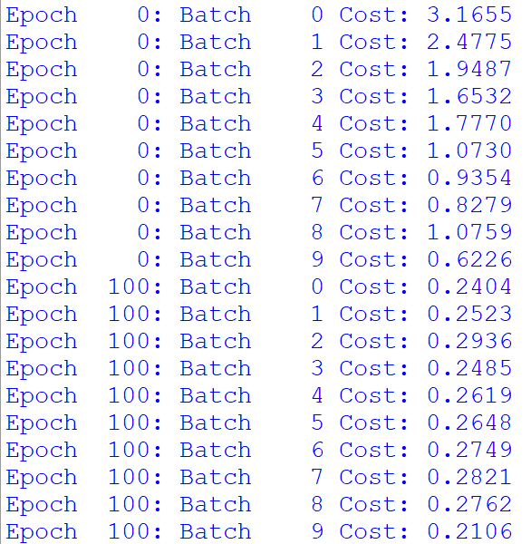
Mini-Batch Softmax Regression in Tensorflow
In the first few epochs we see a general reduction in cost with each batch processed
There is some variability from batch to batch
See Mnist_SoftmaxRegression_tf_3.py

Slide 43
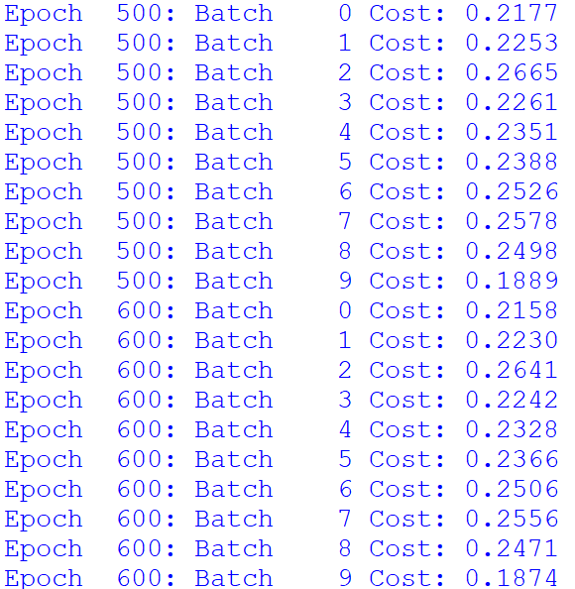
Mini-Batch Softmax Regression in Tensorflow
After several 100s of epochs we see a trend:
The cost per batch varies
The cost of each batch is gradually decreasing
It is hard to tell what the overall cost is
We will need to compute the average cost across batches
See Mnist_SoftmaxRegression_tf_3.py

Slide 44
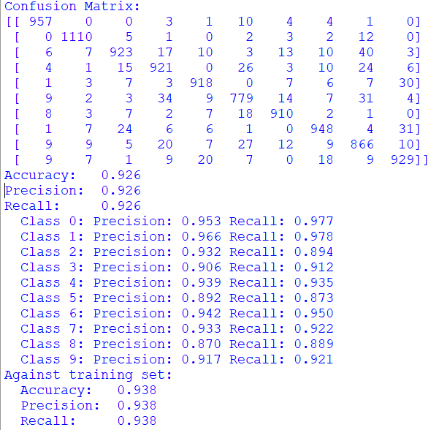
Mini-Batch Softmax Regression in Tensorflow
The results are good
Consistent with full-batch results
See Mnist_SoftmaxRegression_tf_3.py

Slide 45
Practice 3
Consider the mini-batch gradient descent solution of softmax regression of MNIST images
From Mnist_SoftmaxRegression_tf_3.py
In the update loop when the epoch matches the print step, compute and print the average cost for all the mini-batches in this epoch
Also compute the minimum and maximum cost for any mini-batch in this epoch
Hints:
Store the cost values in a list of length n_batches
Move the if (epoch % print_step == 0) outside the batch loop

Slide 46
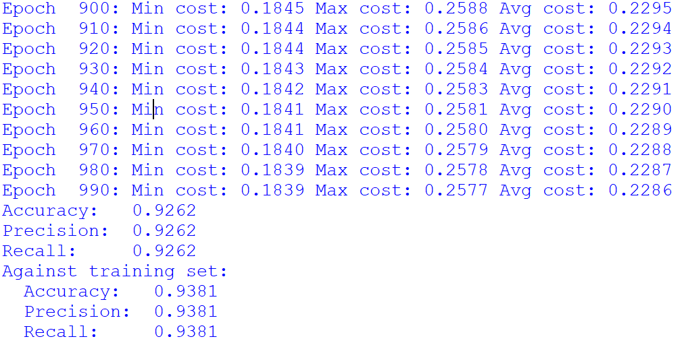
Practice 3

Slide 47
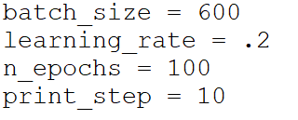
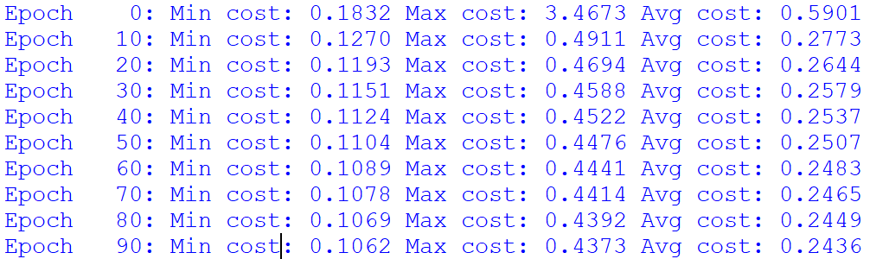

Mini-Batch Softmax Regression in Tensorflow
Let’s try with smaller batches
Lost some accuracy:

Slide 48
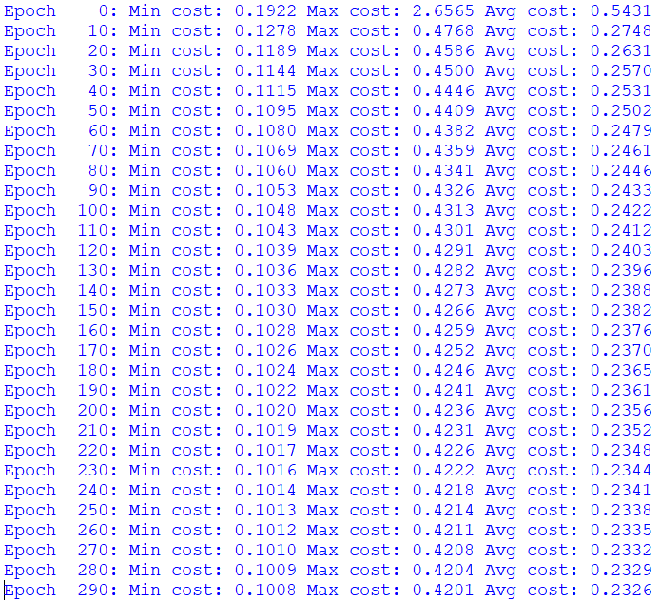

Mini-Batch Softmax Regression in Tensorflow
We can add more iterations
With n_epochs = 300, learning rate = 0.2:
The results did not improve
We need to reduce the learning rate
To average out the noisy mini-batches

Slide 49
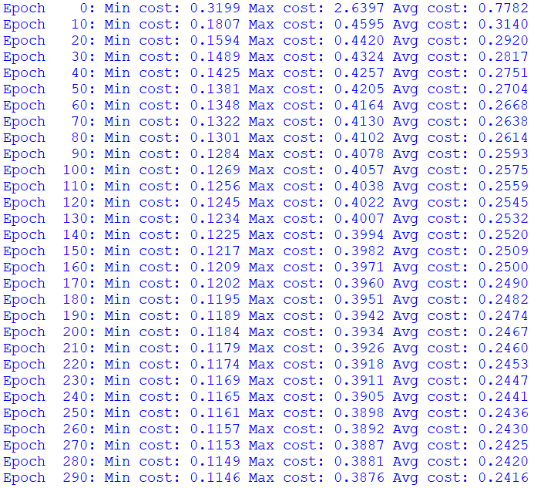

Mini-Batch Softmax Regression in Tensorflow
With:
n_epochs = 300
learning rate = 0.02:
The results are better
The average cost per mini-batch is a little bit higher
But the variance is smaller
The average cost per mini-batch is not necessarily a good indicator of test accuracy
If you want to be sure, compute and print the test accuracy at every print step
See Mnist_SoftmaxRegression_tf_4.py

Slide 50
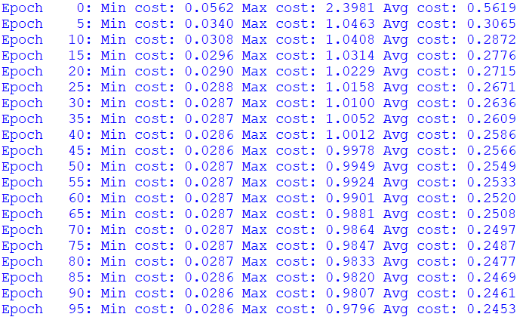

Mini-Batch Softmax Regression in Tensorflow
Let’s try with even smaller batches:
With:
batch_size=60
n_epochs = 100
learning rate = 0.005
The results are good
And it ran much faster
See Mnist_SoftmaxRegression_tf_4.py

Slide 51
Selecting the Batch Size
How to choose the batch size?
There is no hard rule
Generally, the smaller, the faster
Even if you need to add more iterations to compensate
You may need to use smaller learning rate and more iterations if it is very small
Because smaller mini-batches are noisier
Powers of 2 can be more efficient
A common value is 32

Slide 52
Selecting the Learning Rate
There is no hard rule for setting the learning rate
If it is too large, your adaptation will diverge
You will get Inf coefficients
Larger values (that do not diverge) help converge faster
But may not converge deeper
Smaller values may converge deeper
But need more iterations to converge
Recommendation:
Try a few common values (0.1, 0.01, 0.001)
Pick the largest that converges
Let it run with plenty of epochs, until it settles
Try a bit smaller to see if it converges deeper
Adaptive schemes can be more effective (learning-rate schedules)
Start large, and reduce gradually

Slide 53
Thank you

